Slide 1
Blockchain & Cybersecurity
Enhancing security through decentralization

Slide 2
What is Blockchain?

Slide 3
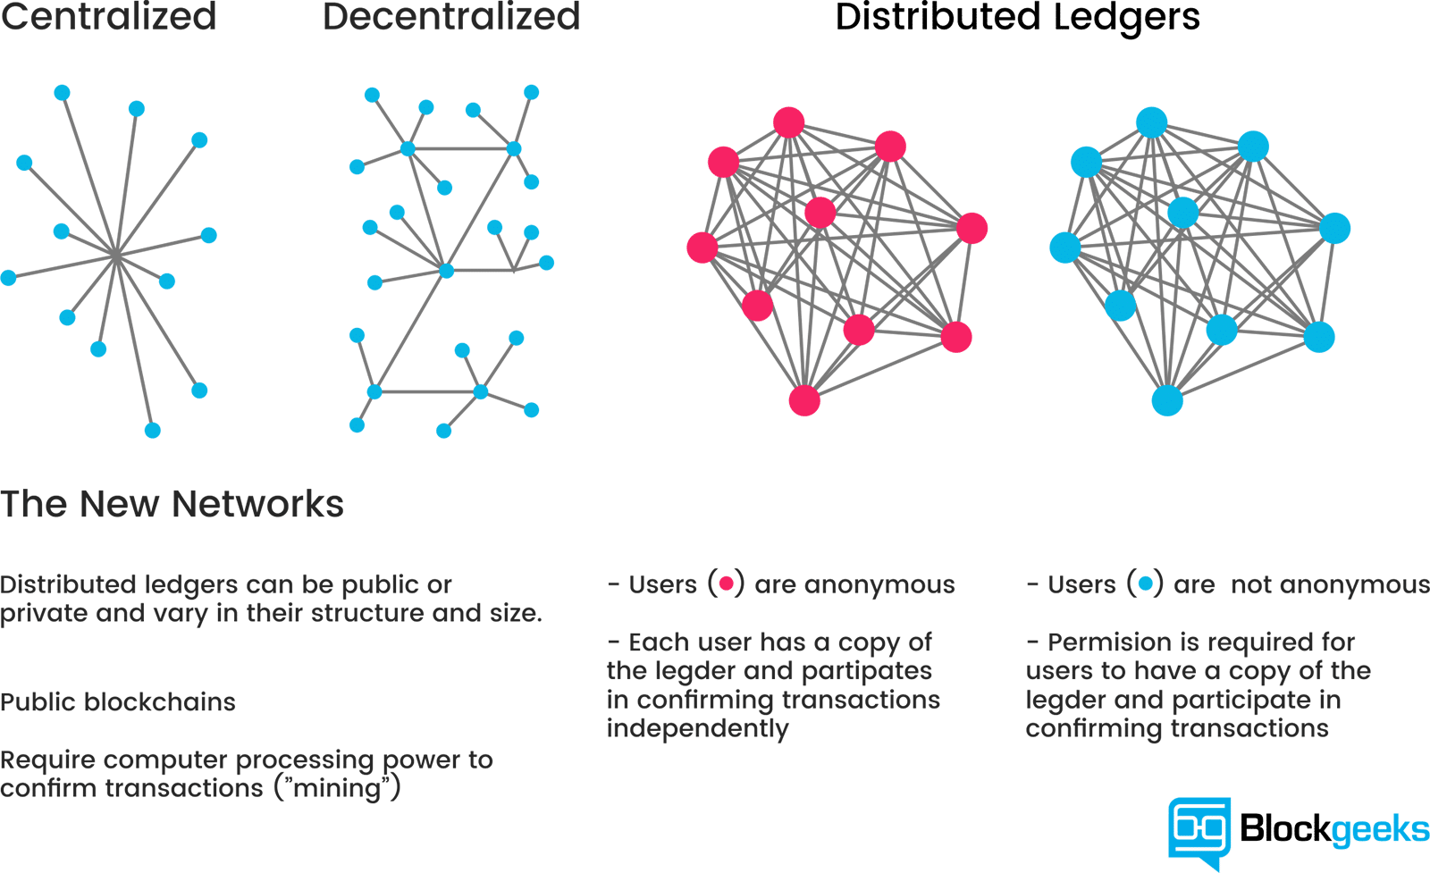
Blockchain is a special kind of Database
Permissioned
Permissionless

Slide 4
Blockchain is a Distributed Ledger
Permissioned
Permissionless

Slide 5
Benefits of Blockchain
Peer to Peer
Each node has direct connections to other nodes
Trustless – No central authority
No worry about manipulation
No transaction cuts
Privacy

Slide 6
Benefits of Blockchain
Data Integrity
Disclaimer: Blockchain ensures data integrity of database, not data input
Entire network maintains same data across different nodes
Stores hash of file instead of actual file
Each file results in a different hash → exact representation
If I hack into one and change the data → Rest of network reject the anomaly
Depending on consensus algorithm, can tolerate <50% compromised systems.
Previously, single point of failure → Just need to hack into 1

Slide 7
How is a Blockchain Fraud-proof?
Each Block has a hash called the Block hash
This hash is defined by the data inside that block
Each Block hash is determined by the previous Block hash
This forms a chain of blocks, all linked together
Changed data from existing blocks will be rejected by the rest of the nodes
Demo

Slide 8
Benefits of Blockchain
Transparency and Auditability
Data on the blockchain is available to everyone
Permissioned: Only nodes in the blockchain
Permissionless: Anyone, even those not in the blockchain
Data is transparent and easily auditable
Hard to cheat participants when everything is auditable
Data Privacy ➔ Zero Knowledge proofs

Slide 9
Benefits of Blockchain
High Availability
As long as one node is online, the system continues to work
Nodes will be reconnected to this node when back online
Even if all nodes are offline, data is not lost
Each node still retains copy of data
Previously, DDoS single point of failure, now Attacker needs to DDoS all nodes
Much more difficult

Slide 10
Benefits of Blockchain
Faster and Cheaper than traditional processes (Using Smart Contracts)
Smart contracts require Blockchain for Fraud-proof attributes
We don’t want contract to be manipulated after activated
Can streamline verification, reconciliation, clearance and other business processes

Slide 11
Cybersecurity Impacts

Slide 12



Data Security
Data integrity for sensitive information
”Our goal is to provide every Soldier...Marine the confidence that they can rely on the information they see and the equipment they operate without fear that it has been manipulated by an outside force,”

Slide 13



IoT
Currently, IoT data requests are aggregated into a single point of trust
The calling device is inherently trusted
Single point of Failure
Blockchain allows IoT devices to form group consensus of normality
Each IoT device has a record of each other’s activity
Trust is distributed to all devices
Able to quarantine IoT devices that behave abnormally

Slide 14

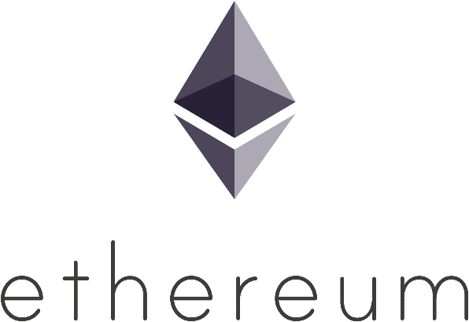
Authentication Protocols
Decentralised Certificate Authorities
Centralised CAs run risk of compromise, internal misuse or mistakes
Decentralising the certificate signing process with multiple parties reduce risk
Storing PKI Certificates on Blockchain
SSL keys on devices directly authenticate with validated certificates
Fake certificates will not be verified due to auditability and immutability of Blockchain

Slide 15
Pentesting

Slide 16
Smart Contracts
With database secured, viable attack vector → Input of data
Injections
Social Engineering
Logic Manipulation
Smart Contracts execute automatically
If compromised, Attacker will directly receive the reward
Due to Blockchain, once reward is sent, it cannot be reversed
Smart Contracts → Future?
Pentesting and Code Audits become more important than ever

Slide 17
Blockchain Network
Nodes are reliant on incoming communication from other nodes
Bitcoin has 8 connections, Ethereum has 13
If communication from nodes are malicious, can influence data recorded
If executed on large enough scale, can partition entire networks
Requires hijacking of Autonomous Systems (AS) or Border Gateway Protocol (BGP)
AS contains the information sent out
BGP determines the routing of information

Slide 18
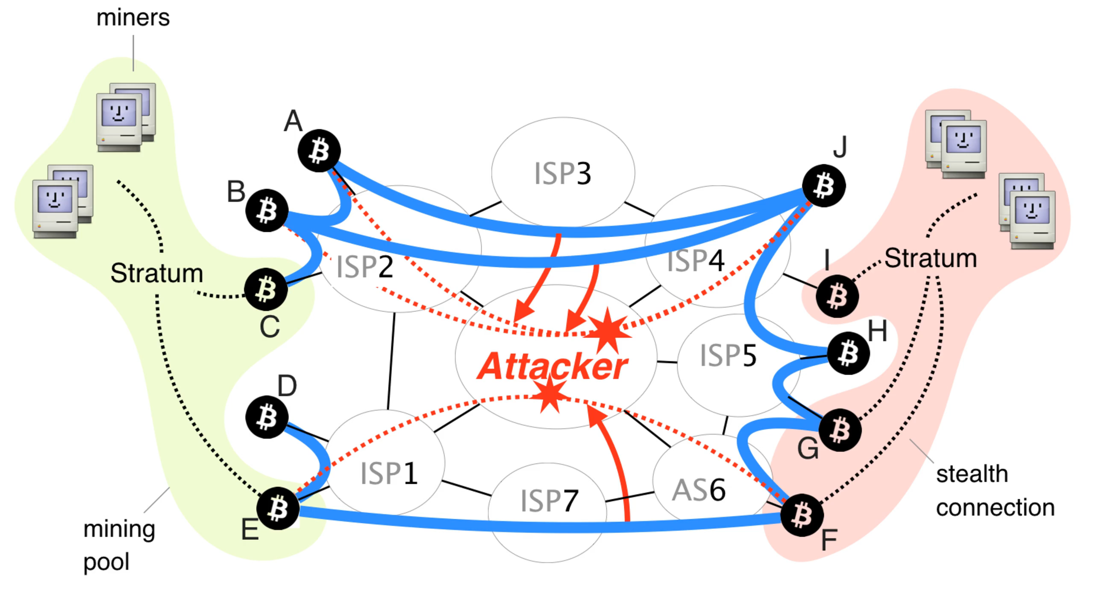

Slide 19


If you are interested to learn more…
HITB GSEC 2018
31 August, 4.30pm - 5.00pm
Blockchain & Smart Contract Attack Vectors
InterContinental® Singapore

Slide 20
Food for thought
Countries and Companies have invested in Blockchain solutions
Smart Contracts looks set to streamline various industries
Singapore has already started using Blockchain (PSA, IMDA, SQ etc)
Can we afford to ignore this? What would happen to the adopters and industries?
Can we secure our future? Or will we be reliant on others?

